Slide 1
Topic: Does Wind Strength have a causal effect on electricity prices?

Slide 2
D = High Wind (> 10 m/s), weighted across points in germany
y = Day ahead price
Confounders:
Sun strength (weighted across germany)
demand
instead of demand: time of day, day of week
Curtailment

Slide 3
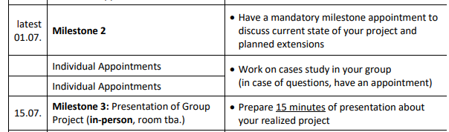
To-Dos
Download Datasets Wind, Sun, Price, Demands(elec)
Find Data on installed solar and wind capacity by region
Weigh wind and sun data by installed solar and wind capacity
Decide which approach to take for modelling
Modelling Data
Presenting data in webapp
Bosse (holiday 14.-28.6.)
Kim

Slide 4
Notes 10.6.
Continous d Toolbox section
DiD would be suitable
Methid suitable to observational data

Slide 5
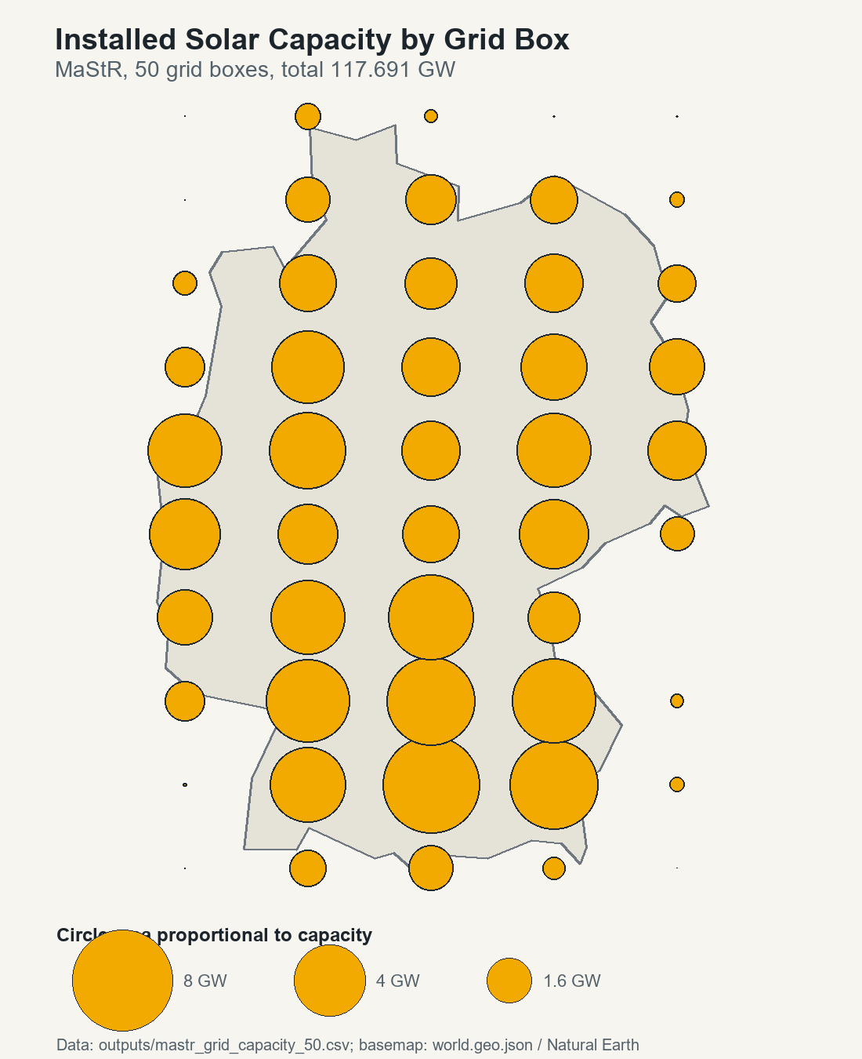
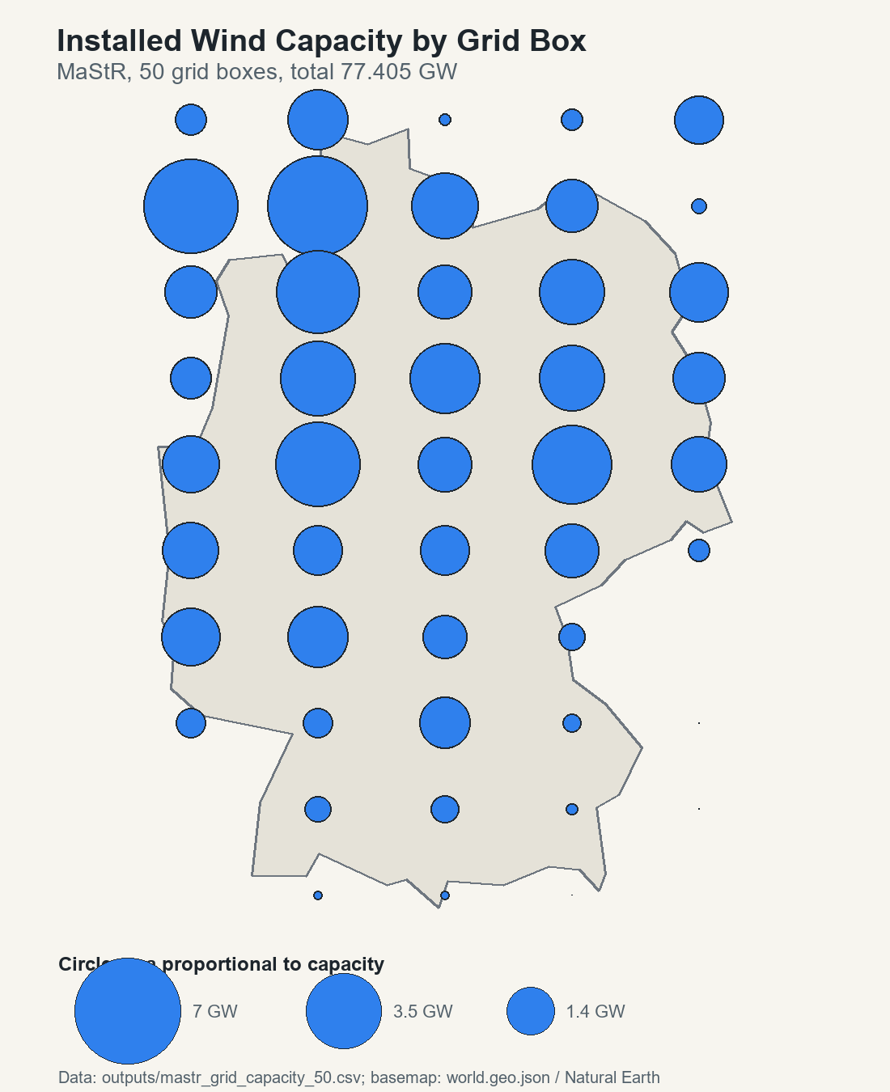
Figure out weights via installed capacity
Data: Marktstammdatenregister (every installed asset with corresponding capacity)
Fit 50 Bins over germany and summing capacities over bins

Slide 6
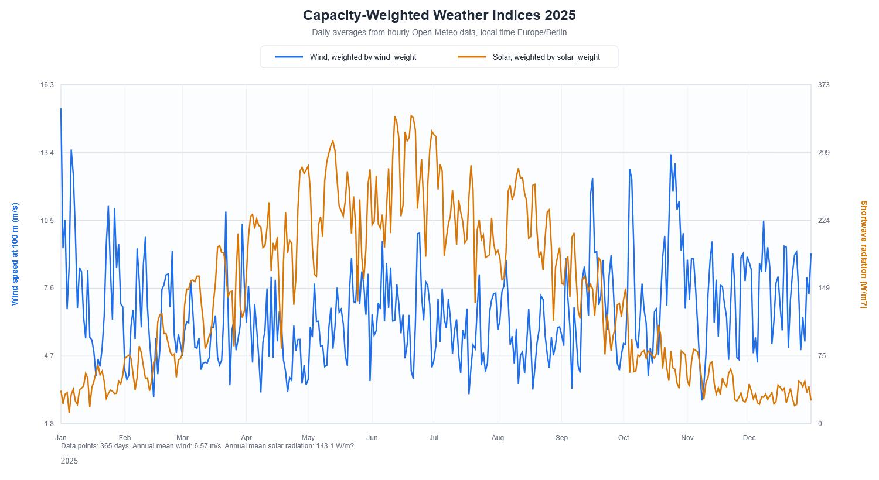
Result: Weighted weather observation
Download hourly weather from OpenMeteo for 2025 at the 50 centerpoints of the bins

Slide 7
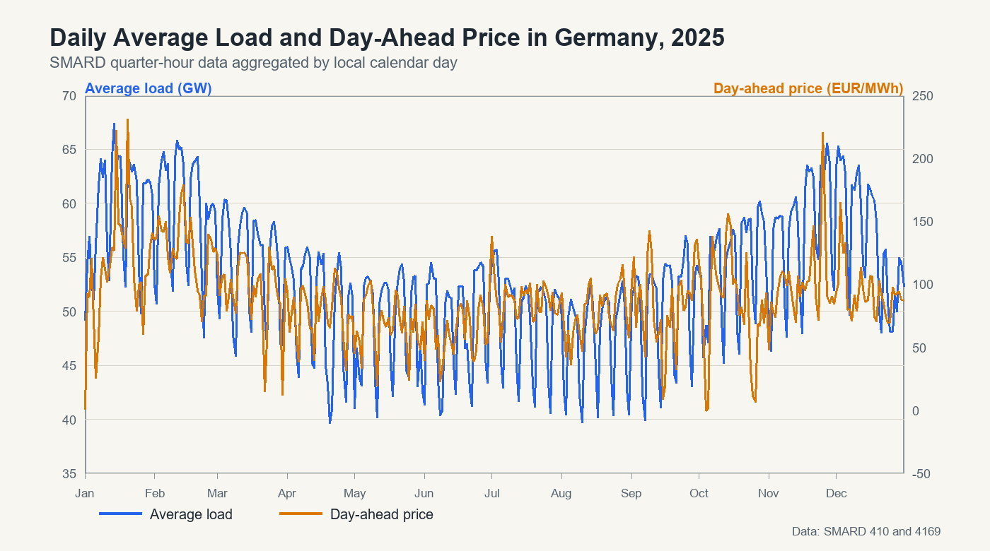
Price and Demand Data
Download via SMARD (1 Year, every 15 minutes)

